Slide 1
Principles of Programming Languages (MCT542 )
Computer Application Department,
RCOEM

Slide 2
Syllabus (MCA SEM- V)
Course Code: MCT542
Courses: Principles of Programming Languages
L:3 Hrs, P: 0 Hrs, Per week
Total Credits: 3

Slide 3
Section-III (Weightage - 35%)
Subprogram and Control Abstraction
Calling Sequence, Access to local variables, Static link, non-local references, Caller and callee responsibilities, Register windows, inline function calls, Parameter passing, Special-Purpose parameters, Generic Subroutines and Modules, Exception Handling, Implementation of Exceptions, Coroutines, Event handling.
Data Abstraction and Object Orientation
Classes, Constructors and Destructors, Implementation issues, Operator Overloading, Templates, Implementation issues for Generic Templates, Representation of an object, Inheritance, Protected Specifier, Dynamic method binding and its implementation, Abstract Classes, Multiple Inheritance.

Slide 4
Subprogram and Control Abstraction
Subprogram and Control Abstraction
Calling Sequence, Access to local variables, Static link, non-local references, Caller and callee responsibilities, Register windows, inline function calls, Parameter passing, Special-Purpose parameters, Generic Subroutines and Modules, Exception Handling, Implementation of Exceptions, Coroutines, Event handling.

Slide 5
Subprogram and Control Abstraction
We sometimes distinguish between control abstraction, in which the principal purpose of the abstraction is to perform a well-defined operation, and
data abstraction, in which the principal purpose of the abstraction is to represent information.
Subroutines/Subprogram are the principal mechanism for control abstraction in most programming languages. A subroutine performs its operation on behalf of a caller, who waits for the subroutine to finish before continuing execution.

Slide 6
Subprogram and Control Abstraction
Most subroutines are parameterized: the caller passes arguments that influence the subroutine’s behavior, or provide it with data on which to operate. Arguments are also called actual parameters. They are mapped to the subroutine’s formal parameters at the time a call occurs.
A subroutine that returns a value is usually called a function. A subroutine that does not return a value is usually called a procedure.

Slide 7
Subprogram and Control Abstraction
Records
the allocation of space on a subroutine call stack

Slide 8
Subprogram and Control Abstraction
Each routine, as it is called, is given a new stack frame, or activation record, at the top of the stack. This frame may contain arguments and/or return values, bookkeeping information (including the return address and saved registers), local variables, and/or temporaries. When a subroutine returns, its frame is popped from the stack.
At any given time, the stack pointer register contains the address of either the last used location at the top of the stack, or the first unused location, depending on convention.

Slide 9
Subprogram and Control Abstraction
The frame pointer register contains an address within the frame. Objects in the frame are accessed via displacement addressing with respect to the frame pointer.

Slide 10
Subprogram and Control Abstraction

Slide 11
Subprogram and Control Abstraction
Calling Sequences
Maintenance of the subroutine call stack is the responsibility of the calling sequence—the code executed by the caller immediately before and after a subroutine call—and of the prologue (code executed at the beginning) and epilogue (code executed at the end) of the subroutine itself.
Prologue: code executed at the beginning
Epilogue: code executed at the end

Slide 12
Subprogram and Control Abstraction
Maintenance of the subroutine call stack is the responsibility of the calling sequence—the code executed by the caller immediately before and after a subroutine call—and of the prologue and epilogue of the subroutine itself.
Tasks that must be accomplished on the way into a subroutine include passing parameters, saving the return address, changing the program counter, changing the stack pointer to allocate space, saving registers that contain important values and that may be overwritten by the callee, changing the frame pointer to refer to the new frame, and executing initialization code for any objects in the new frame that require it.

Slide 13
Subprogram and Control Abstraction
Tasks that must be accomplished on the way out include passing return parameters or function values, executing finalization code for any local objects that require it, deallocating the stack frame, restoring other saved registers , and restoring the program counter. Some of these tasks (e.g., passing parameters) must be performed by the caller, because they differ from call to call.

Slide 14
Subprogram and Control Abstraction
A Typical Calling Sequence
The stack pointer (sp) points to the first unused location on the stack (or the last used location, depending on the compiler and machine).
The frame pointer (fp) points to a location near the bottom of the frame.

Slide 15
Subprogram and Control Abstraction
To maintain this stack layout, the calling sequence might operate as follows.
The caller
saves any caller-saves registers whose values will be needed after the call
computes the values of arguments and moves them into the stack or registers
computes the static link (if this is a language with nested subroutines), and passes it as an extra, hidden argument
uses a special subroutine call instruction to jump to the subroutine, simultaneously passing the return address on the stack or in a register
In its prologue, the callee
1. allocates a frame by subtracting an appropriate constant from the sp
2. saves the old frame pointer into the stack, and assigns it an appropriate new value

Slide 16
To maintain this stack layout, the calling sequence might operate as follows.
The caller
1. saves any caller-saves registers whose values will be needed after the call
2. computes the values of arguments and moves them into the stack or registers
3. computes the static link (if this is a language with nested subroutines), and
passes it as an extra, hidden argument
4. uses a special subroutine call instruction to jump to the subroutine, simultaneously
passing the return address on the stack or in a register
In its prologue, the callee
1. allocates a frame by subtracting an appropriate constant from the sp
2. saves the old frame pointer into the stack, and assigns it an appropriate new
value

Slide 17
Subprogram and Control Abstraction
The calling sequence is the code a caller executes to set up a new subroutine
Responsibilities:
On the way in: Pass parameters, save return address, change program counter, change stack pointer, save registers that might be overwritten, changing frame pointer to new frame, and initializing code for new objects in the new frame
On the way out: passing return parameters/values, executing finalization code for local objects, deallocating the stack frame, restoring registers, and restoring the PC

Slide 18
Subprogram and Control Abstraction
Records

Slide 19
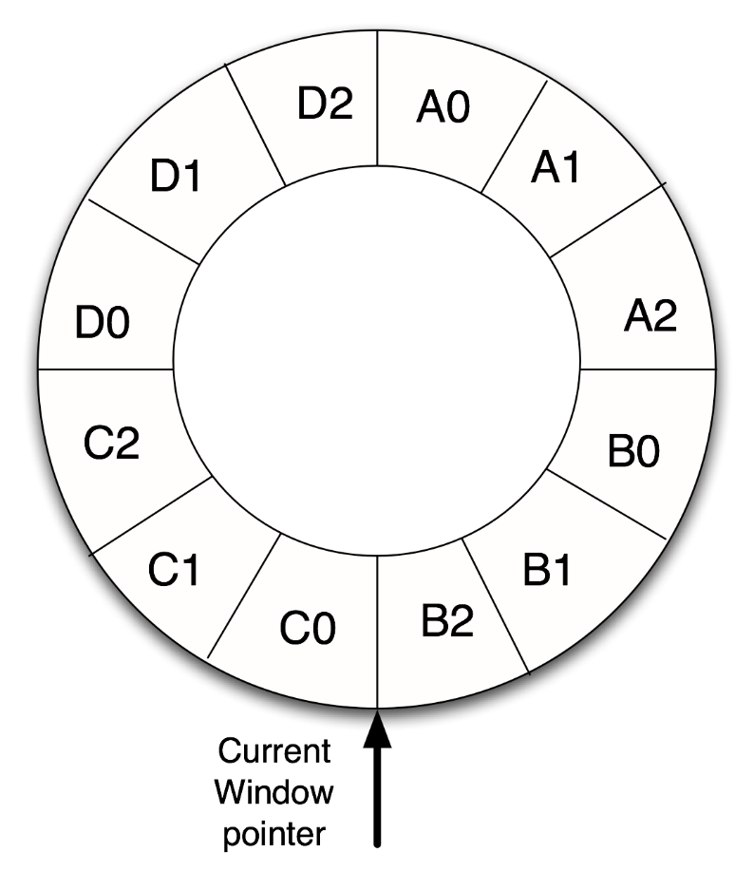
Register Window
Registers are used by CPU in order to hold temporary values while working on longer stings of instructions.
Register windows are implemented to improve the performance of a processor by reducing the number of stack operations required for function calls and returns.
There are three parts in a window upper is input register (0) , middle one is local register (1) and the lower is the output register(2).

Slide 20
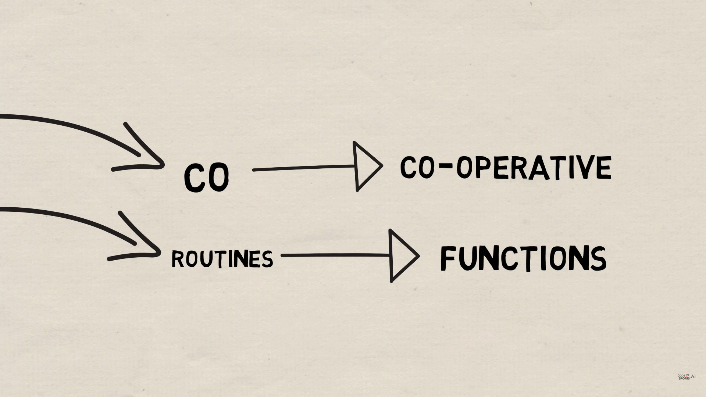
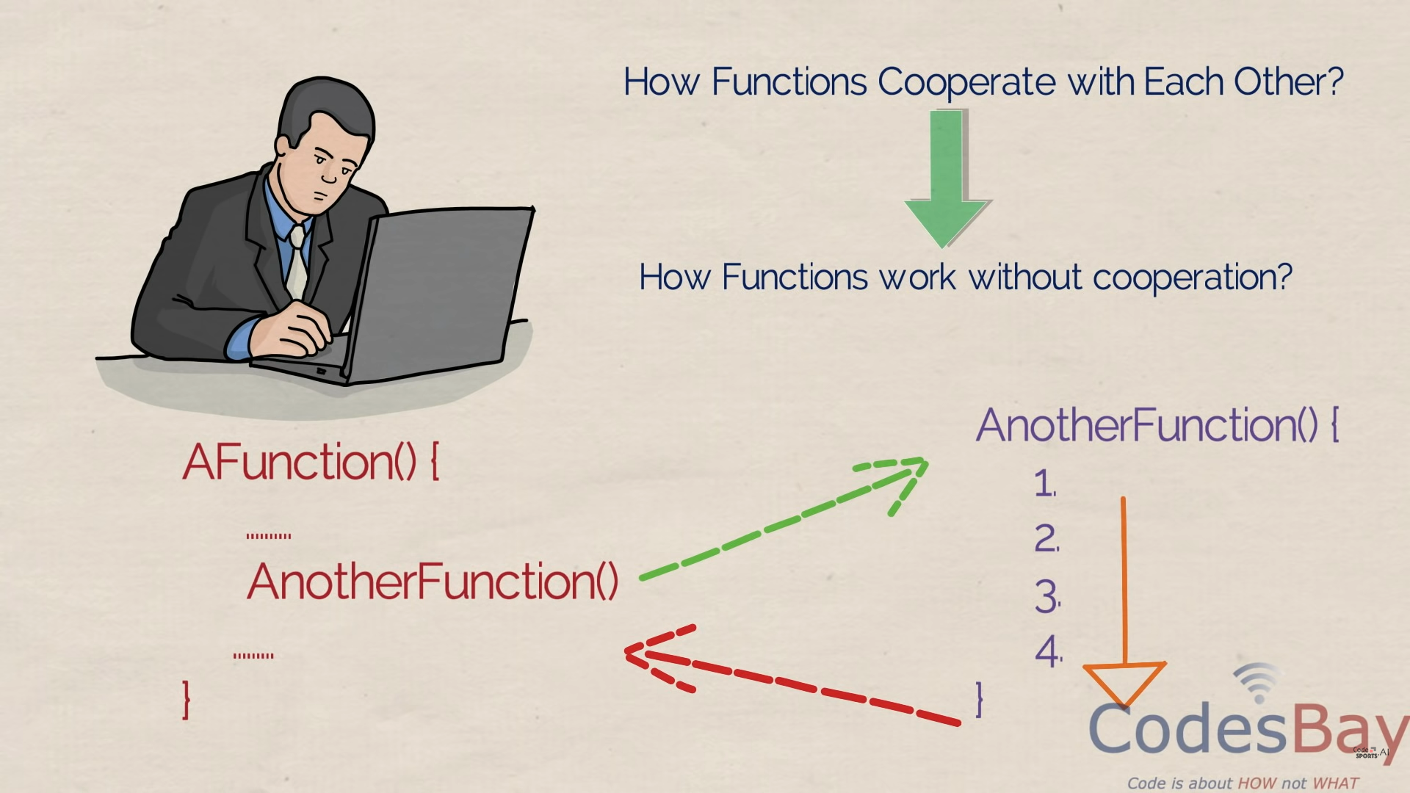
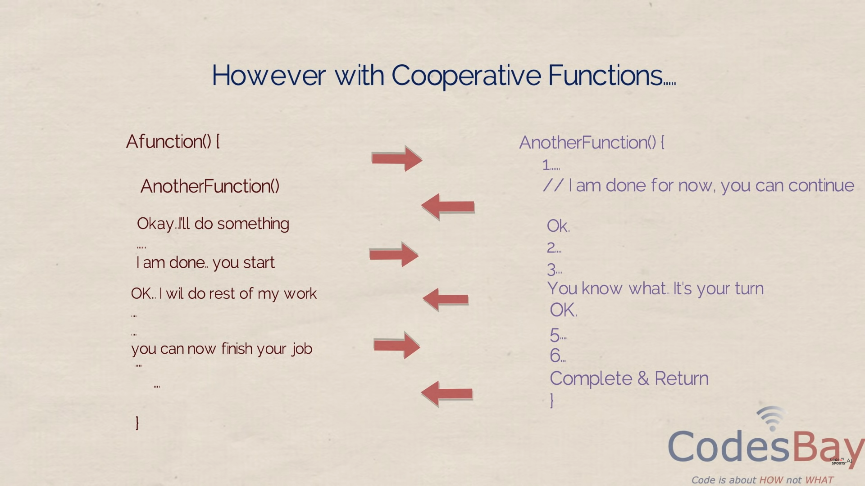
Coroutines

Slide 21
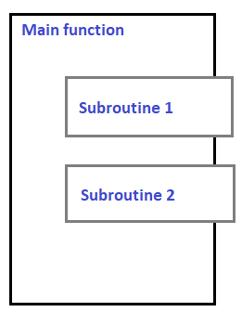
Introduction
In computer programming, a subroutine is a sequence of program instructions that perform a specific task.
For example a program for addition, subtraction. Subroutines is also known as function.

Slide 22
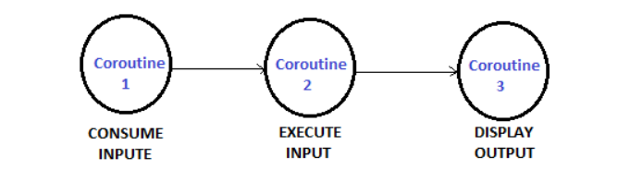
Coroutines are generalizations of the subroutines.
A subroutine has the same starting point and the same endpoint all the time, while a coroutine has multiple entry points for suspending and resuming execution.
Coroutine is a function that allows pausing its own execution and resuming from the exact same point after a condition is met.
Coroutines are cooperative, that means if a coroutine consume input data, another coroutine can consume it, and another coroutine can be used to display the output.
Coroutines are nothing but cooperative functions.
Only one coroutine can run at a given time.

Slide 23
Control transfer between coroutines
Coroutine is a special kind of subprogram. Coroutines have multiple entry points which are controlled by themselves. They also have means to maintain their status between various activations.
This means coroutines must be history sensitive and thus have static local variables.
Coroutines often begin at points other than its beginning. Because of this, the invocation of coroutine is called resume rather than call.

Slide 24
Only one coroutine executes at a given time. Rather than executing to their other ends, coroutines often partially execute and then transfer control to other coroutines. When restarted, a coroutine resumes execution just after the statement it used to transfer control elsewhere. Coroutines are created in an application by a program unit called master unit, which is not a coroutines. When created, coroutine executes their initialization code, and then returns control to that master unit.

Slide 25
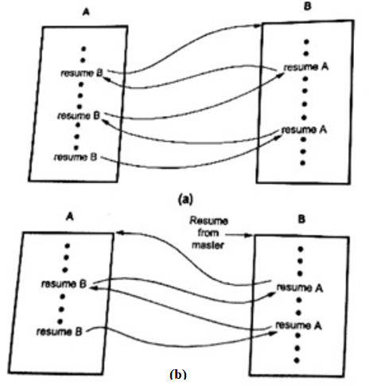
Suppose, programs A and B are coroutines. In Fig. the execution of a corouting A is started by the master unit. After some execution, A starts B. When coroutine B in fig. (a) first causes control to return to coroutine A, the semantics is that A continues from where it ended its last execution. In particular, its local variables have the values left then by the previous activation.
Fig. (b) shows alternative execution sequence of coroutines A and B. In this case, B is started by the master unit.

Slide 26
Coroutines are supported by Simula and Modula-2. They are similar to Java’s threads, except the programmer has to explicitly transfer control from one execution context to another.
Thus, like threads several coroutines can exist simultaneously but unlike threads there is no central scheduler that decides which coroutine should run next.
A coroutine is represented by a closure.
A special operation transfer(C) shifts control to the coroutine C, at the location where C last left off.

Slide 27
A coroutine is a programming construct between function and thread.
It behaves like a function that can suspend itself arbitrarily often to yield intermediate results and to get new inputs before returning a result.
This facility makes coroutines suitable for implementing generator abstractions.

Slide 28
Difference between coroutine and threads
The major difference is that coroutines are cooperative. A thread is preemptive.
Both have some form of a context tracking unit. Both have a method to change from one context to another.
The thread uses a clock/interrupt based event to change context in addition to what a co-routine uses, where a co-routine uses a function call (something to “yield to another context”), and the co-routine can be resumed later following that function call.

Slide 29
// Coroutine that calculates the 10th Fibonacci number in a background thread someScope.launch(Dispatchers.Default) { val fibonacci10 = synchronousFibonacci(10) saveFibonacciInMemory(10, fibonacci10) }
private fun synchronousFibonacci(n: Long): Long { /* ... */ }
The above coroutine’s block of code, that performs a synchronous and blocking fibonacci calculation and saves it to memory, gets dispatched and scheduled for execution in a thread pool managed by the coroutines library, the one configured for Dispatchers.Default. The code will be executed in a thread of the thread pool at some time in the future depending on the thread pool’s policies.
Note that the code above executes in one thread because it doesn’t suspend. It’s possible for one coroutine to be executed in different threads if the execution is moved to a different dispatcher, or if the block contains code that may yield/suspend in a dispatcher that uses a thread pool.

Slide 30
Similarly, without coroutines, you could execute the logic above using threads manually as follows:
// Create a thread pool of 4 threads val executorService = Executors.newFixedThreadPool(4)// Schedule and execute this code in one of those threads executorService.execute { val fibonacci10 = synchronousFibonacci(10) saveFibonacciInMemory(10, fibonacci10) }
While doing things on your own managing thread pools manually is possible, coroutines is the recommended solution for asynchronous programming on Android due to the built-in cancellation support, easier error handling, structured concurrency which reduces the likelihood of memory leaks, and its integration with Jetpack libraries.

Slide 31
Stack Allocation for Coroutines
Coroutines cannot share a single stack: their subroutine calls and returns, taken as a whole, do not occur in last-in-first-out order. If each coroutine is declared at the outermost level of lexical nesting, then their stacks are entirely disjoint: the only objects they share are global, and thus statically allocated.

Slide 32
Subprogram and Control Abstraction
The simplest solution is to give each coroutine a fixed amount of statically allocated stack space. This approach is adopted, which requires the programmer to specify in Modula-2 the size and location of the stack when initializing a coroutine.
It is a run-time error for the coroutine to need additional space.
If stack frames are allocated from the heap, as they are in most Lisp and Schem implementations, then the problems of overflow and internal fragmentation are avoided. At the same time, the overhead of each subroutine call is significantly increased

Slide 33
Subprogram and Control Abstraction
Events
An event is something to which a running program (a process) needs to respond, but which occurs outside the program, at an unpredictable time.
The most common events are inputs to a graphical user interface (GUI) system: keystrokes, mouse motions, button clicks. They may also be network operations or other asynchronous I/O activity: the arrival of a message, the completion of a previously requested disk operation.

Slide 34
Subprogram and Control Abstraction
We assumed that a program looking for input will request it explicitly, and will wait if it isn’t yet available. This sort of synchronous (at a specified time) and blocking (potentially wait-inducing) input is generally not acceptable for modern applications with graphical interfaces.
Instead, the programmer usually wants a handler—a special subroutine—to be invoked when a given event occurs. Handlers are sometimes known as callback functions, because the run-time system calls back into the main program instead of being called from it. In an object oriented language, the callback function may be a method of some handler object, rather than a static subroutine.

Slide 35
Subprogram and Control Abstraction
Sequential Handlers
Traditionally, event handlers were implemented in sequential programming languages as “spontaneous” subroutine calls, typically using a mechanism defined and implemented by the operating system.
At the hardware level, asynchronous device activity during P’s execution will trigger an interrupt mechanism that saves P’s registers, switches to a different stack, and jumps to a predefined address in the OS kernel.

Slide 36
Subprogram and Control Abstraction
Records

Slide 37
Subprogram and Control Abstraction
The language run-time library contains a block of code known as the signal trampoline. It also includes a buffer writable by the kernel and readable by the runtime.
Before delivering a signal, the kernel places the saved state of P into the shared buffer.
It then switches back to P’s user-level stack and jumps into the signal trampoline. The trampoline creates a frame for itself in the stack and then calls the event handler using the normal subroutine calling sequence.

Slide 38
Subprogram and Control Abstraction
When the event handler returns, the trampoline restores state (including all registers) from the buffer written by the kernel, and jumps back into the main program. To avoid recursive events, the kernel typically disables further signals when it jumps to the signal trampoline.
Immediately before jumping back to the user program, the trampoline performs a kernel call to reenable signals. Depending on the details of the operating system, the kernel may buffer some modest number of signals while they are disabled, and deliver them once the handler reenables them.

Slide 39
Subprogram and Control Abstraction
Thread-Based Handlers
In modern programming languages and run-time systems, events are often handled by a separate thread of control, rather than by spontaneous subroutine calls.
With a separate handler thread, input can again be synchronous: the handler thread makes a system call to request the next event, and waits for it to occur.
The main program continues to execute. If the program wishes to be able to handle multiple events concurrently, it may create multiple handler threads, each of which calls into the kernel to wait for an event.

Slide 40
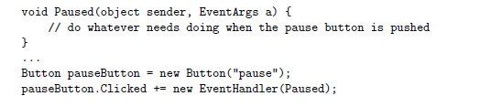
Subprogram and Control Abstraction
Many contemporary GUI systems are thread-based. Examples include the OpenGL Utility Toolkit (GLUT), the GNU ImageManipulation Program (GIMP) Tool Kit (Gtk), the Java Swing library,Windows Forms, and the newer .NETWindows Presentation Foundation (WPF).
An event handler in C#

Slide 41
Section-III (Weightage - 35%):
Data Abstraction and Object Orientation
Classes, Constructors and Destructors, Implementation issues, Operator Overloading, Templates, Implementation issues for Generic Templates, Representation of an object, Inheritance, Protected Specifier, Dynamic method binding and its implementation, Abstract Classes, Multiple Inheritance.
Note: Exception handling and Inline function topics are common in both part 1 and part 2 of section 3

Slide 42
Data Abstraction and Object Orientation
Introduction to Abstraction-
Abstraction is the concept of object-oriented programming that "shows" only essential attributes and "hides" unnecessary information.
Abstraction is selecting data from a larger pool to show only relevant details of the object to the user.
Data abstraction refers to providing only essential information about the data to the outside world, hiding the background details or implementation.
e.g.

Slide 43
Data Abstraction and Object Orientation
The abstraction provided by modules and module types has at least three important benefits
It reduces conceptual load by minimizing the amount of detail that the programmer must think about at one time.
It provides fault containment by preventing the programmer from using a program component in inappropriate ways, and by limiting the portion of a program’s text in which a given component can be used, thereby limiting the portion that must be considered when searching for the cause of a bug.
It provides a significant degree of independence among program components, making it easier to assign their construction to separate individuals, to modify their internal implementations without changing external code that uses them, or to install them in a library where they can be used by other programs.

Slide 44
In C++, classes provides great level of data abstraction. They provide sufficient public methods to the outside world to play with the functionality of the object and to manipulate object data, i.e., state without actually knowing how class has been implemented internally.
For example, a program can make a call to the sort() function without knowing what algorithm the function actually uses to sort the given values. In fact, the underlying implementation of the sorting functionality could change between releases of the library, and as long as the interface stays the same, your function call will still work.
In C++, we use classes to define our own abstract data types (ADT). We can use the cout object of class ostream to stream data to standard output like this −
#include <iostream>
using namespace std;
int main()
{
cout << "Hello C++" <<endl;
return 0;
}
Here, you don't need to understand how cout displays the text on the user's screen. You need to only know the public interface and the underlying implementation of ‘cout’ is free to change.

Slide 45
Classes and Objects
A class can be thought of as an extension of the structures which are used in a language like C
A class is essentially a structure with subroutines. That is, a class is not only a container for data, but it also provides functions (called class methods) which manipulate that data in precisely defined ways.
Objects are ‘instances’ of a class (type of object). Classes are templates or blueprints for building objects.
Each class is designed to represent some functional grouping of data and processing within the program.

Slide 46
Contents of Classes
class class_name {
... data fields, constants...
... methods...
... constructors...
... properties...
... derived classes...
}

Slide 47
Example of class and object
// Program to illustrate the working of
// objects and class in C++ Programming
#include <iostream>
using namespace std;
// create a class
class Room {
public:
double length;
double breadth;
double height;
double calculateArea() {
return length * breadth;
}
double calculateVolume() {
return length * breadth * height;
}
};
int main() {
// create object of Room class
Room room1;
// assign values to data members
room1.length = 42.5;
room1.breadth = 30.8;
room1.height = 19.2;
// calculate and display the area and volume of the room
cout << "Area of Room = " << room1.calculateArea() << endl;
cout << "Volume of Room = " << room1.calculateVolume() << endl;
return 0;
}
Output:
Area of Room = 1309
Volume of Room = 25132.8

Slide 48
Example of class and multiple objects
#include <iostream>
using namespace std;
// Create a Car class with some attributes class Car { public: string brand; string model; int year; }; int main() { // Create an object of Car Car carObj1; carObj1.brand = "BMW"; carObj1.model = "X5"; carObj1.year = 1999; // Create another object of Car Car carObj2; carObj2.brand = "Ford"; carObj2.model = "Mustang"; carObj2.year = 1969; // Print attribute values cout << carObj1.brand << " " << carObj1.model << " " << carObj1.year << "\n"; cout << carObj2.brand << " " << carObj2.model << " " << carObj2.year << "\n"; return 0; }

Slide 49
Access Specifiers in C++
In C++, there are three access specifiers:
public -
The public keyword is used to create public members (data and functions).
The public members are accessible from any part of the program , i.e. Pulbic members are accessible from outside the class
private –
The private keyword is used to create private members (data and functions).
The private members can only be accessed from within the class, i.e. members cannot be accessed (or viewed) from outside the class
However, friend classes and friend functions can access private members.
protected –
The protected keyword is used to create protected members (data and function).
The protected members can be accessed within the class and from the derived class i.e. members cannot be accessed from outside the class, however, they can be accessed in inherited classes.
Protected elements are just like the private, except they can be accessed by derived classes.

Slide 50
Example of public specifier
#include <iostream>
using namespace std;
// define a class
class Sample {
// public elements
public:
int age;
void displayAge() {
cout << "Age = " << age << endl;
}
};
int main() {
// declare a class object
Sample obj1;
cout << "Enter your age: ";
// store input in age of the obj1 object
cin >> obj1.age;
// call class function
obj1.displayAge();
return 0;
}
Output
Enter your age: 20
Age = 20

Slide 51
Example of private specifier
.
#include <iostream>
using namespace std;
// define a class
class Sample {
// private elements
private:
int age;
// public elements
public:
void displayAge(int a) {
age = a;
cout << "Age = " << age << endl;
}
};
int main() {
// declare a class object
Sample obj1;
cout << "Enter your age: ";
// store input in age of the obj1 object
cin >> obj1.age;
// call class function
obj1.displayAge();
return 0;
}
Output
Enter your age: 20
Age = 20
Note : In main(), the object obj1 cannot directly access the class variable age. We can only indirectly manipulate age through the public function displayAge() since this function initializes age with the value of the argument passed to it i.e. the function parameter int a

Slide 52
Example of protected specifier
.
#include <iostream>
using namespace std;
// declare parent class
class Sample {
// protected elements
protected:
int age;
};
// declare child class
class SampleChild : public Sample {
public:
void displayAge(int a) {
age = a;
cout << "Age = " << age << endl;
}
};
int main() {
int ageInput;
// declare object of child class
SampleChild child;
cout << "Enter your age: ";
cin >> ageInput;
// call child class function
// pass ageInput as argument
child.displayAge(ageInput);
return 0;
}
Output
Enter your age: 20
Age = 20
Note : Here SampleChild is an inherited class that is derived from Sample. The variable age is declared in Sample with protected Keyword. This means that SampleChild can access age since Sample is the parent class.

Slide 53
Visibility Modes in C++
Here is a table that summarizes the access restrictions in inheritance:
Access Mode | Base Class Member | Derived Class Member
public | public | public
 | protected | protected
 | private | INACCESSIBLE
protected | public | protected
 | protected | protected
 | private | INACCESSIBLE
private | public | private
 | protected | private
 | private | INACCESSIBLE

Slide 54
Inheritance
The capability of a class to derive properties and characteristics from another class is called Inheritance. Inheritance is one of the most important feature of Object Oriented Programming.
Sub Class: The class that inherits properties from another class is called Sub class or Derived Class.
Super Class: The class whose properties are inherited by sub class is called Base Class or Super class.

Slide 55
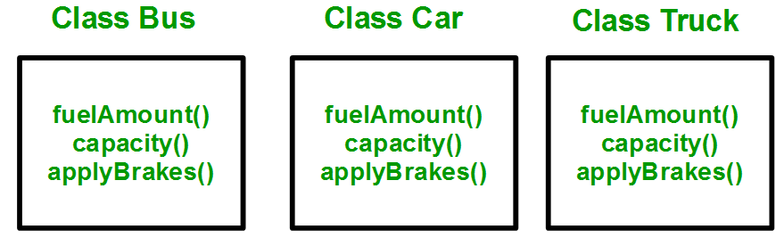
Why and when to use inheritance?
Consider a group of vehicles. You need to create classes for Bus, Car and Truck. The methods fuelAmount(), capacity(), applyBrakes() will be same for all of the three classes. If we create these classes avoiding inheritance then we have to write all of these functions in each of the three classes as shown in below figure:

Slide 56
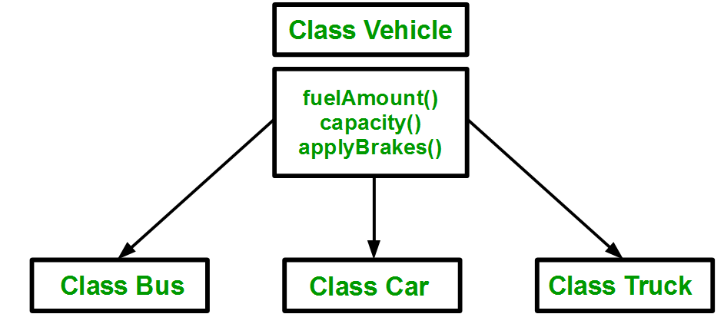
Data Abstraction and Object Orientation
You can clearly see that above process results in duplication of same code 3 times. This increases the chances of error and data redundancy. To avoid this type of situation, inheritance is used.
Using inheritance, we have to write the functions only one time instead of three times as we have inherited rest of the three classes from base class(Vehicle).

Slide 57
Implementing inheritance in C++: For creating a sub-class which is inherited from the base class we have to follow the below syntax.
Syntax:
class subclass_name : access_mode base_class_name
{
//body of subclass
};

Slide 58
Data Abstraction and Object Orientation
// C++ program to demonstrate //implementation of Inheritance
#include <iostream>
using namespace std;
//Base class
class Parent
{
public:
int id_p;
};
// Sub class inheriting from //Base Class(Parent)
class Child : public Parent
{
public:
int id_c;
};
//main function
int main()
{
Child obj1;
// An object of class child has all data members
// and member functions of class parent
obj1.id_c = 7;
obj1.id_p = 91;
cout << "Child id is " << obj1.id_c << endl;
cout << "Parent id is " << obj1.id_p << endl;
return 0;
}

Slide 59
Data Abstraction and Object Orientation
Modes of Inheritance
Public mode: If we derive a sub class from a public base class. Then the public member of the base class will become public in the derived class and protected members of the base class will become protected in derived class.
Protected mode: If we derive a sub class from a Protected base class. Then both public member and protected members of the base class will become protected in derived class.
Private mode: If we derive a sub class from a Private base class. Then both public member and protected members of the base class will become Private in derived class.

Slide 60
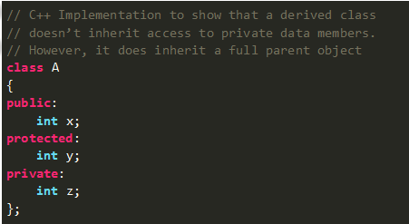
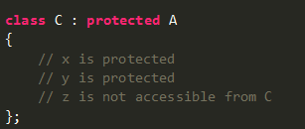
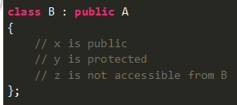
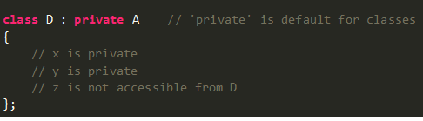
Data Abstraction and Object Orientation

Slide 61
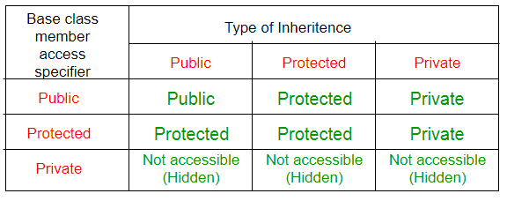
Data Abstraction and Object Orientation

Slide 62
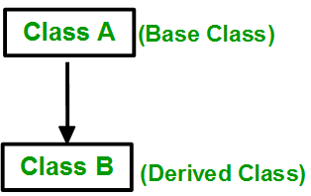
Data Abstraction and Object Orientation
Types of Inheritance in C++
1. Single Inheritance: In single inheritance, a class is allowed to inherit from only one class. i.e. one sub class is inherited by one base class only.
https://www.geeksforgeeks.org/inheritance-in-c/

Slide 63
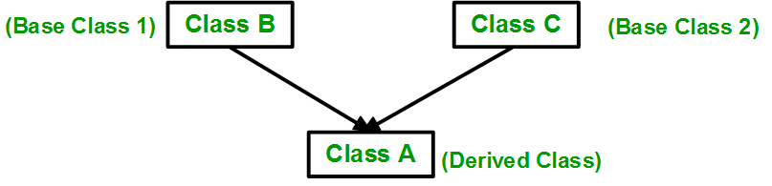
Data Abstraction and Object Orientation
2. Multiple Inheritance: Multiple Inheritance is a feature of C++ where a class can inherit from more than one classes. i.e one sub class is inherited from more than one base classes.
Syntax:
class A
{
..........
};
class B
{
...........
} ;
class C : acess_specifier A, access_specifier B // derived class from A and B
{
...........
} ;

Slide 64
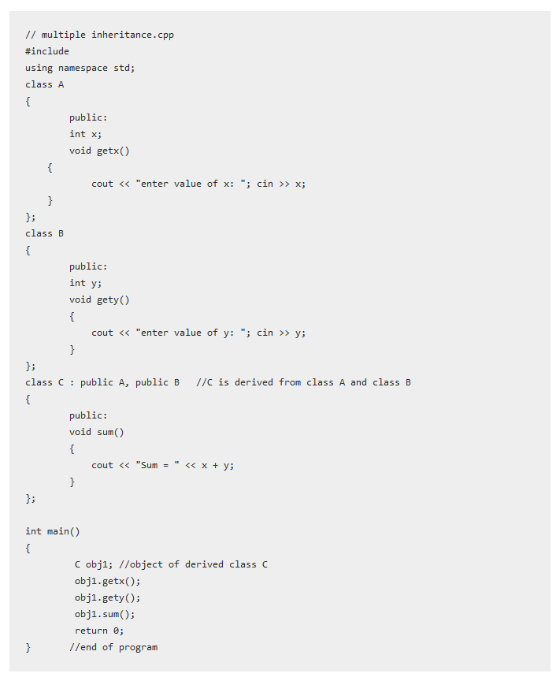
Output
enter value of x: 5
enter value of y: 4
Sum = 9

Slide 65
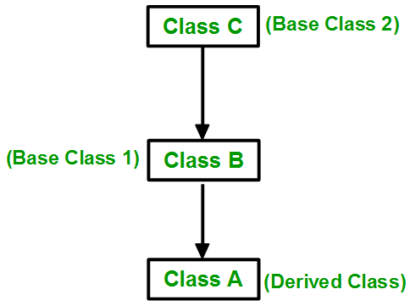
Data Abstraction and Object Orientation
3. Multilevel Inheritance: In this type of inheritance, a derived class is created from another derived class.
Syntax;
class A // base class
{
...........
};
class B : acess_specifier A // derived class
{
...........
} ;
class C : access_specifier B // derived from derived class B
{
...........
} ;

Slide 66
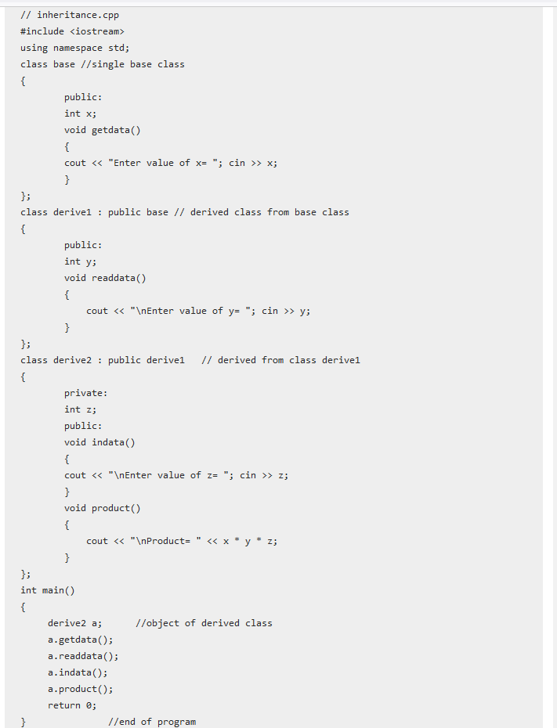
Output:
Enter value of x= 2
Enter value of y= 3
Enter value of z= 3
Product= 18

Slide 67
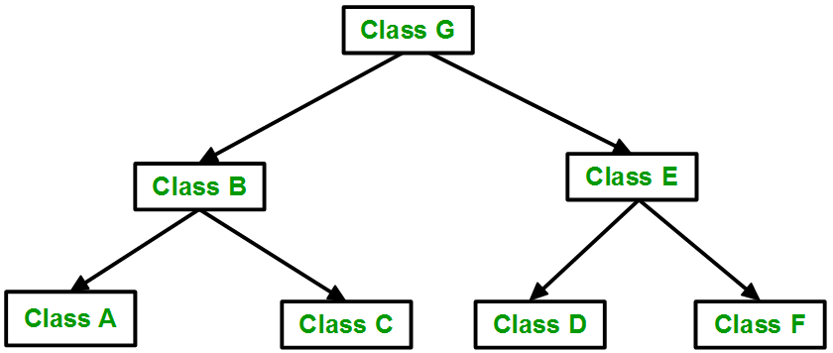
Data Abstraction and Object Orientation
4. Hierarchical Inheritance: In this type of inheritance, more than one sub class is inherited from a single base class. i.e. more than one derived class is created from a single base class.

Slide 68
Syntax :
class Parent_classname { Common_properties; methods; }; class derived_class1:visibility_mode parent_classname { Common_properties; methods; }; class derived_class2:visibility_mode parent_classname { Common_ properties; methods; }; . . . . class derived_classN:visibility_mode parent_classname { Common_properties; methods; };

Slide 69
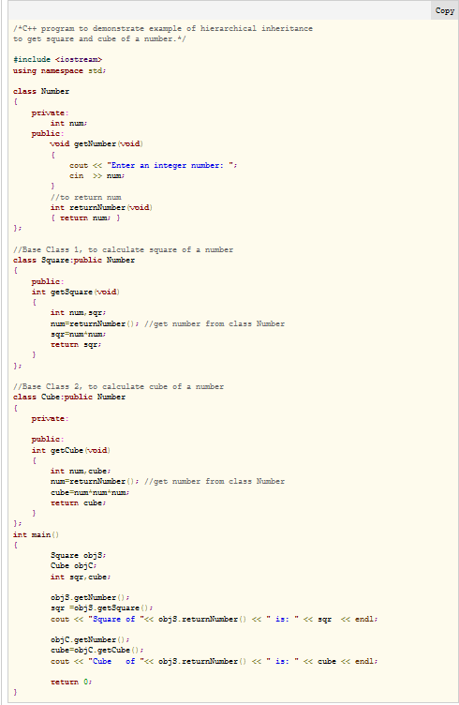
/*C++ program to demonstrate example of hierarchical inheritance to get square and cube of a number.*/ #include <iostream> using namespace std; class Number { private: int num; public: void getNumber(void) { cout << "Enter an integer number: "; cin >> num; } //to return num int returnNumber(void) { return num; } }; //Base Class 1, to calculate square of a number class Square:public Number { public: int getSquare(void) { int num,sqr; num=returnNumber(); //get number from class Number sqr=num*num; return sqr; } }; //Base Class 2, to calculate cube of a number class Cube:public Number { private: public: int getCube(void) { int num,cube; num=returnNumber(); //get number from class Number cube=num*num*num; return cube; } }; int main() { Square objS; Cube objC; int sqr,cube; objS.getNumber(); sqr =objS.getSquare(); cout << "Square of "<< objS.returnNumber() << " is: " << sqr << endl; objC.getNumber(); cube=objC.getCube(); cout << "Cube of "<< objS.returnNumber() << " is: " << cube << endl; return 0; }
Enter an integer number: 10 Square of 10 is: 100 Enter an integer number: 20 Cube of 10 is: 8000

Slide 70
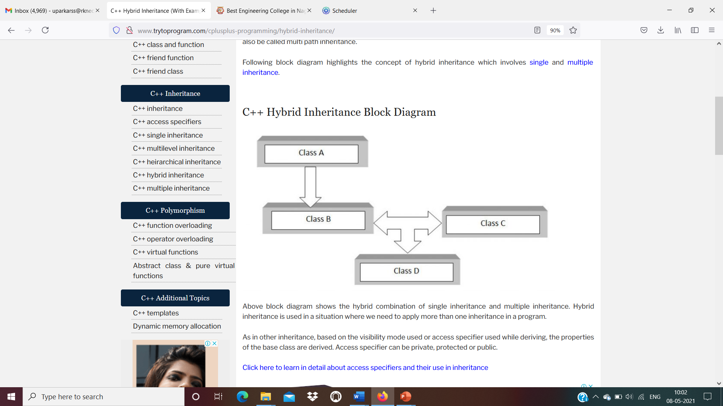
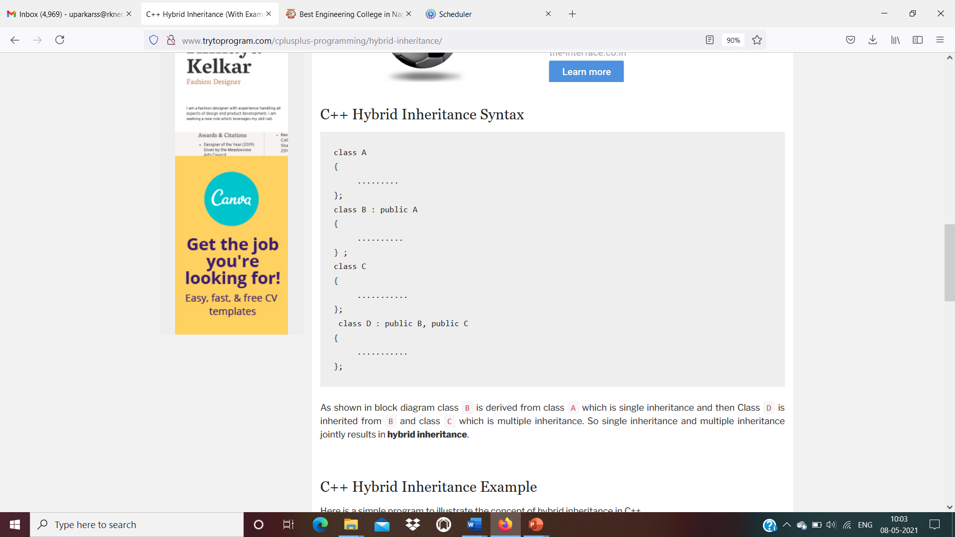
Hybrid Inheritance

Slide 71
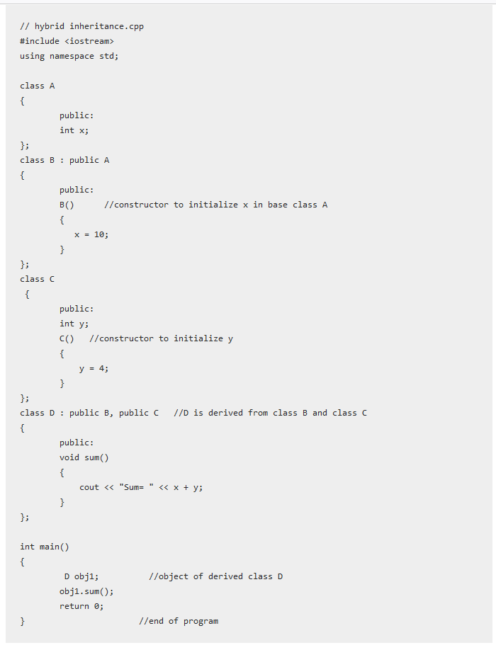
Output
Sum=14

Slide 72
Initialization and Assignment in C++
Initialization gives a variable an initial value at the point when it is created.
Assignment gives a variable a value at some point after the variable is created.
Note : This topic has been extended in terms of constructor

Slide 73
Constructor
A constructor is a special member function that is used to initialize objects of a class instantaneously when it is constructed.
A constructor is a member function that has the same name as that of the class.
It is defined as any other member functions (both inside or outside) of the class.
Since a constructor just defines the value to a data member, there’s no return type to it.
They are called automatically when the objects are created.
They should be declared in the public section of the class.

Slide 74
// Without Constructor
#include <iostream>
using namespace std;
class car
{
private:
float mileage;
public:
void setdata()
{
cin>>mileage;
{
};
int main()
{
car c1,c2;
c1.setdata;
c2.setdata;
return 0;
}
// With Constructor
#include <iostream>
using namespace std;
class car
{
private:
float mileage;
public:
// same name as class name
// similar to member function
car()
{
cin>>mileage;
{
};
int main()
{
car c1,c2;
// Called automatically on creation of object(s).
return 0;
}

Slide 75
Constructors can be defined either inside the class definition or outside class definition using class name and scope resolution :: operator.
class A
{
public:
int i;
A(); // constructor declared
};
// constructor definition
A::A()
{
i = 1;
}

Slide 76
Points to be noted for constructor
Constructor should be declared in public section because private constructor cannot be invoked outside the class so they are useless.
Constructors do not have return type and they cannot return value, not even void.
Constructors cannot be inherited, even though a derived class can call the base class constructor.
Constructors cannot be virtual.
They make implicit call to the operator new and delete when memory allocation is required.
A constructor must not be a coroutine.

Slide 77
Destructor
// Constructor and Destructor
#include <iostream>
using namespace std;
class car
{
private:
float mileage;
public:
// same name as class name
// similar to member function
car()
{
cin>>mileage;
{
~car()
{
cout<<“destructor”;
{
};
int main()
{
car c1,c2;
// Called automatically on creation of object(s).
return 0;
}
Destructor is used to destroy the objects that have been created by a constructor.
The syntax of destructor is same as that for constructor,
The class name is used for the name of destructor,
With a tilde(~) sign as prefix to it.
Destructor never takes any argument nor it return any value nor it has return type.
Destructor is invoked automatically by the complier upon exit form the program.

Slide 78
Types of Constructors
Default Constructor
A constructor which does not have any arguments is called a Default Constructor, or a ‘Zero Argument Constructor’.
In a default constructor, every object in the class is initialized to the same set of values. It is not possible to initialize different objects with different initial values. This is one of the disadvantages of a default constructor.
Syntax: Consider a class with the name world. The default constructor for this class would be:
world::world() //default constructor without any arguments
Note: Any constructor with arguments is not a default constructor.

Slide 79
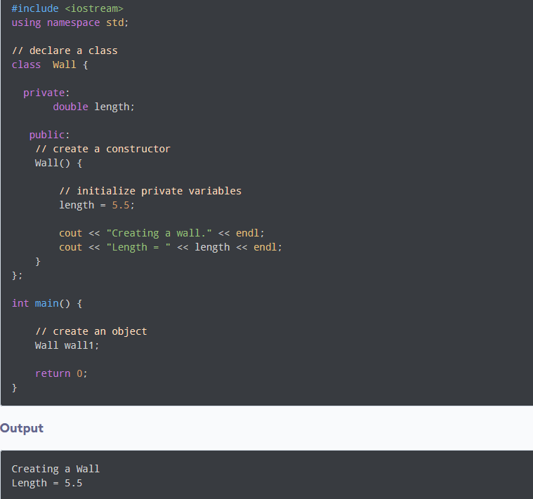

Slide 80
Parameterized constructor
To avoid the infeasibility of default constructor to accept arguments, we use Parameterized Constructor, which is a constructor that can accept one or more arguments.
It works the same way as a default constructor, but the difference is that it can hold arguments. They are also called automatically once the objects are created.
Syntax: Consider a class with the name world. The parameterized constructor for this class would be:
world::world(int a, int b) //parameterized constructor with arguments
Note: The parameterized constructors can be overloaded.

Slide 81
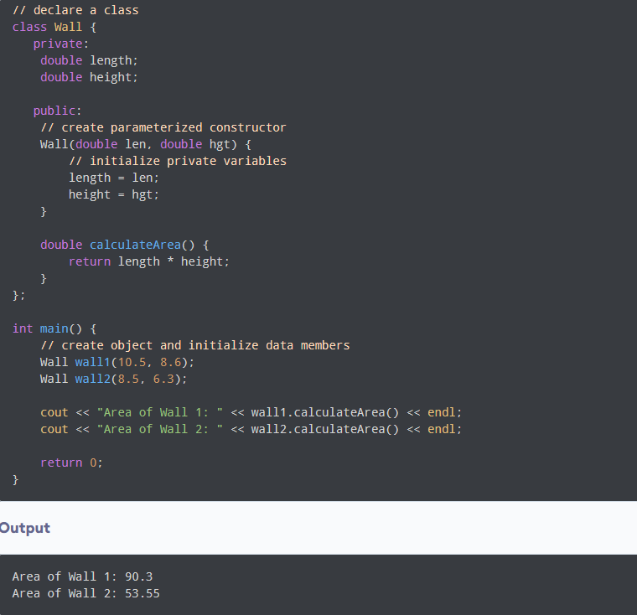

Slide 82
Copy Constructor
Copy Constructor is a type of parameterized constructor in which the properties of one object can be copied to another object. It is used to initialize an object with the values of already existing objects. A copy constructor is invoked when an existing object is passed as a parameter.
Syntax: Consider a class with the name world. The copy constructor for this class would be:
world::world(world &ptr) //copy constructor
where ptr is the pointer to the class object.
Note: Copy constructors cannot be invoked explicitly.

Slide 83
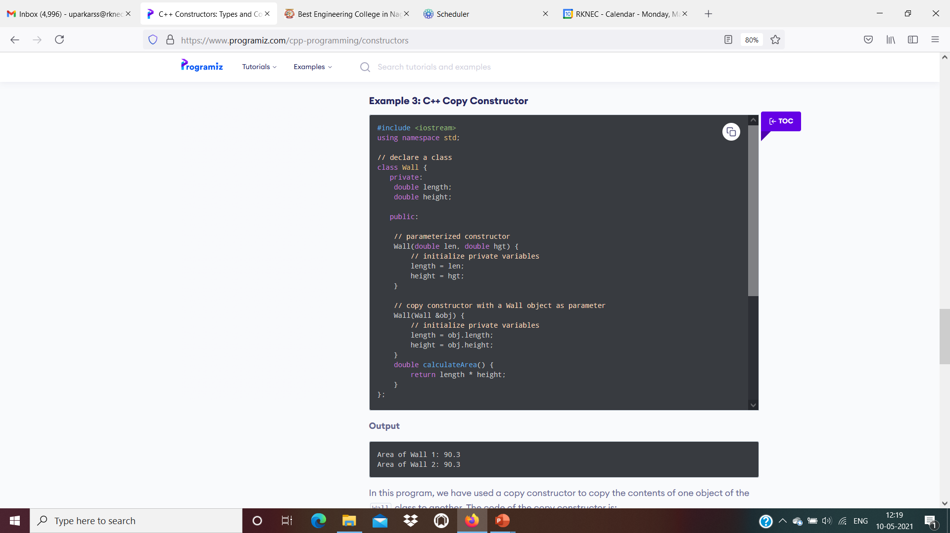
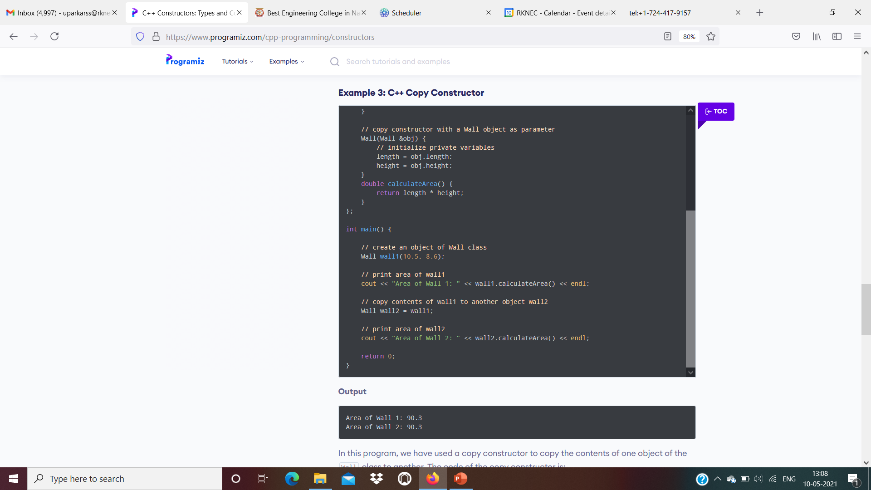

Slide 84
Invoking (Calling) Constructors
Explicit call is a method of invoking constructors in which the declaration of an object is done by using assignment operator(=), constructor name followed by argument list.
Syntax is
constructor_name object_name=constructor_name(argument list);
demo d1=demo(5.5)
Note: d1 acts as the object which transfers the value 5.5 explicitly to the constructor demo. The name of the class and constructor will be demo.

Slide 85
Invoking (Calling) Constructors
Implicit call is a method of invoking constructors in which the declaration of an object is done and is then followed by an argument list.
Syntax is
constructor_name object_name(argument list);
demo d1(5.5)
Note: The name of the class and constructor will be demo. The constructor will be parameterized by taking one argument. Here, d1 acts as the object which transfers the value 5.5 implicitly to the constructor.
For different values, different objects have to be initialized in the main function.

Slide 86
Inline Function and Macros
Also, Expectation handling using class concept

Slide 87
Inline Function
In C++, we can declare a function as inline.
This copies the function to the location of the function call in compile-time and may make the program execution faster.
To create an inline function, we use the inline keyword.
Syntax is
inline returnType functionName(parameters) {
// code
}
Inline functions are commonly used when the function definitions are small, and the functions are called several times in a program.

Slide 88
#include <iostream>
using namespace std;
inline void displayNum(int num) {
cout << num << endl;
}
int main() {
displayNum(5);
displayNum(8);
displayNum(666);
return 0;
}
#include <iostream>
using namespace std;
inline void displayNum(int num) {
cout << num << endl;
}
int main() {
cout << 5 << endl;
cout << 8 << endl;
cout << 666 << endl;
return 0;
}
Compilation
Note: Each time when displayNum() is called, the compiler copies the code of the function to that call location.

Slide 89
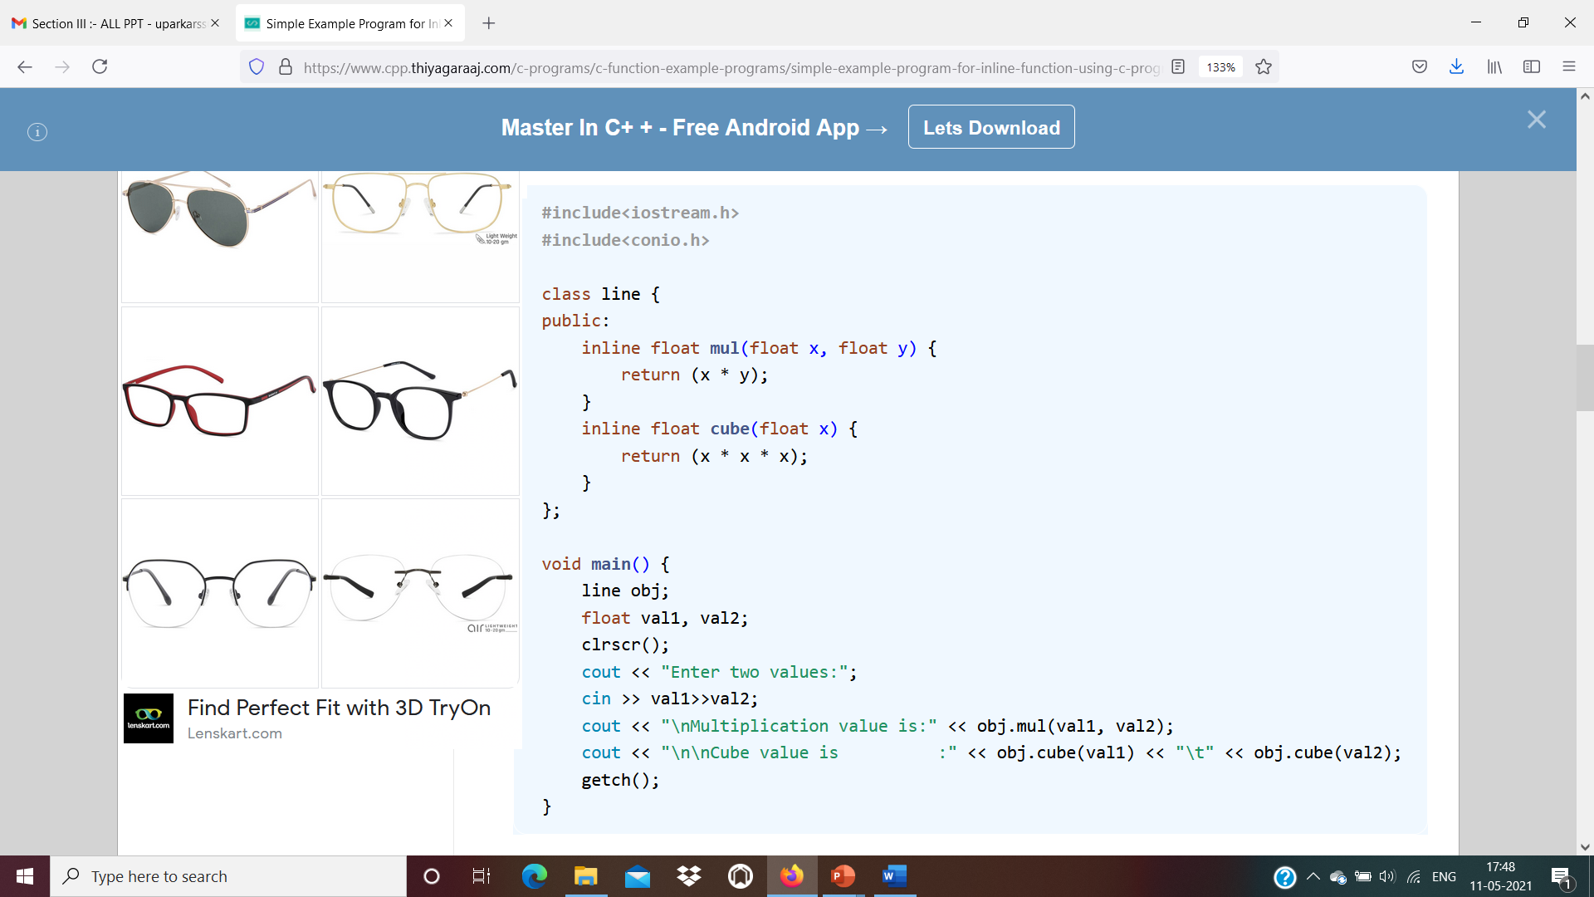
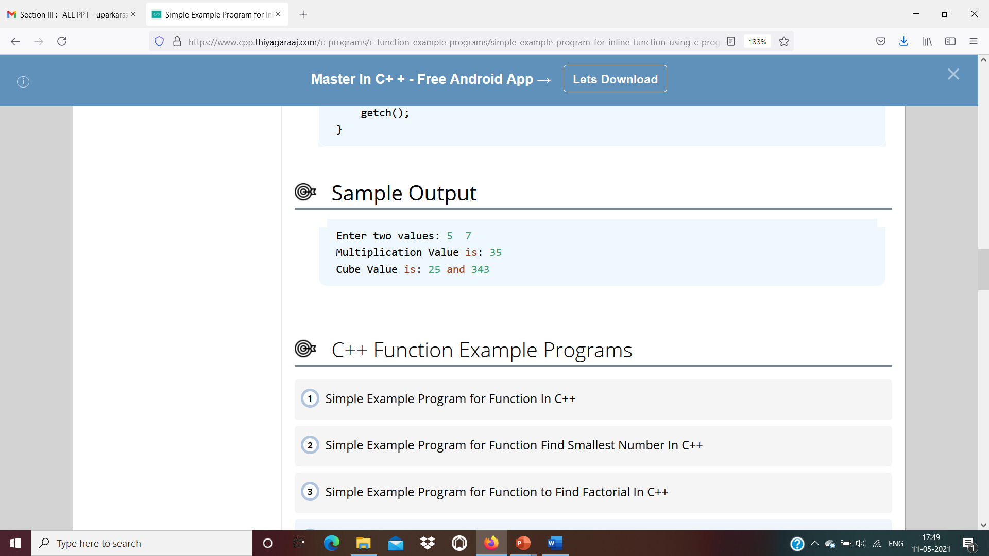
This style is considered as a bad programming style. The best programming style is to just write the prototype of function inside the class and specify it as an inline in the function definition.

Slide 90
#include <iostream>
using namespace std;
class operation
{
int a,b,add,sub,mul;
float div;
public:
void get();
void sum();
void difference();
};
inline void operation :: get()
{
cout << "Enter first value:";
cin >> a;
cout << "Enter second value:";
cin >> b;
}
inline void operation :: sum()
{
add = a+b;
cout << "Addition of two numbers: " << a+b << "\n";
}
inline void operation :: difference()
{
sub = a-b;
cout << "Difference of two numbers: " << a-b << "\n";
}
int main()
{
cout << "Program using inline function\n";
operation s;
s.get();
s.sum();
s.difference();
return 0;
}
Output
Enter first value: 45
Enter second value: 15
Addition of two numbers: 60
Difference of two numbers: 30

Slide 91
Remark
We should note that inlining is only a request to the compiler, not a command. The compiler can ignore and skip the request for inlining. The compiler may not perform inlining in the following circumstances:
If a function contains a loop. (for, while, do-while)
If a function is recursive.
If a function contains static variables.
If a function contains a switch command or goto statement.
For a function not returning values, if a return statement exists.
C++ compiler checks the argument types of inline functions and necessary conversions are performed correctly. Preprocessor macro is not capable for doing this. The macros are managed by preprocessor and inline functions are managed by C++ compiler.

Slide 92
Macros:
A macro is a piece of code in a program that is replaced by the value of the macro.
Macro is defined by #define directive. Whenever a micro name is encountered by the compiler, it replaces the name with the definition of the macro.
Macro definitions need not be terminated by semi-colon(;).
Types of Macro are-
Object-like Macros:used to replace a symbolic name to numerical/variable represented as constant. e.g. - #define LIMIT 5
Chain Macros: (Macros inside macros), first of all parent macro is expand then child macro is expanded. - e.g.
#define INSTAGRAM FOLLOWERS
#define FOLLOWERS 138
Multi-line Macros: An object-like macro could have a multi-line. So to create a multi-line macro you have to use backslash-newline.
Function-like Macro: These macros are the same as a function call. It replaces the entire code instead of a function name. Pair of parentheses immediately after the macro name is necessary.
#define ELE 1, \
2, \
3
int arr[] = { ELE };
#define min(a, b) (((a) < (b)) ? (a) : (b))
#define AREA(l, b) (l * b)

Slide 93
Macros in C
The C preprocessor is a macro preprocessor (allows you to define macros) that transforms your program before it is compiled. These transformations can be the inclusion of header file, macro expansions etc.
All preprocessing directives begin with a # symbol. For example,
#define PI 3.14
Including Header Files: #include
The #include preprocessor is used to include header files to C programs. For example,
#include <stdio.h>
Here, stdio.h is a header file. The #include preprocessor directive replaces the above line with the contents of stdio.h header file.
That's the reason why you need to use #include <stdio.h> before you can use functions like scanf() and printf().

Slide 94
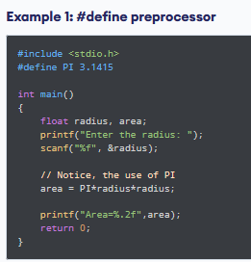
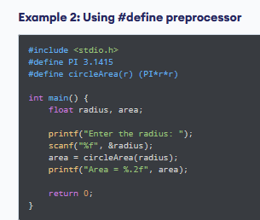
Subprogram and Control Abstraction
s

Slide 95
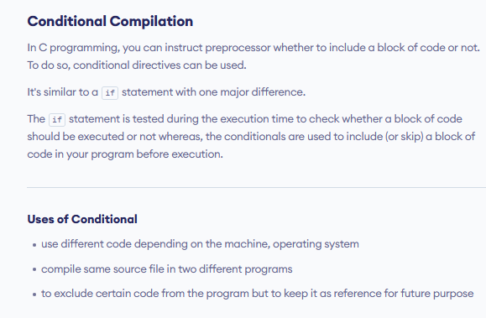
Subprogram and Control Abstraction

Slide 96
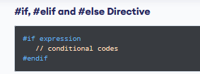
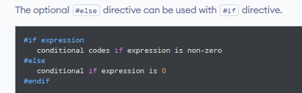
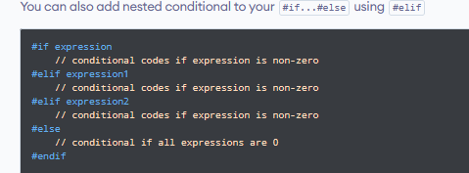
Subprogram and Control Abstraction
s

Slide 97
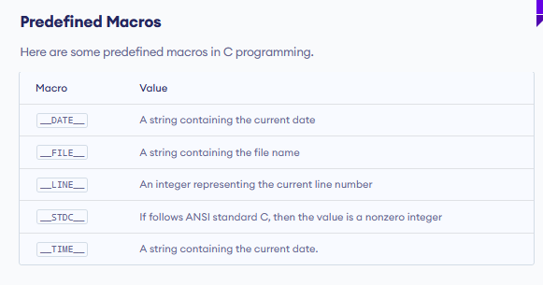
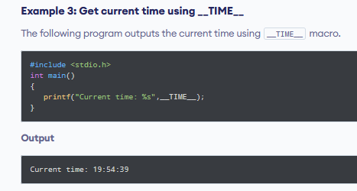

Slide 98
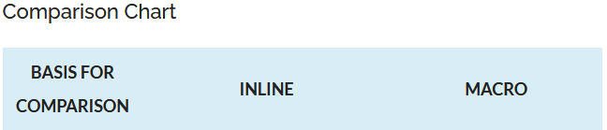
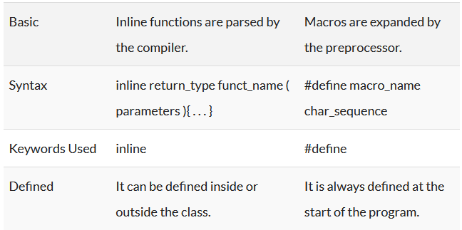
Subprogram and Control Abstraction
Difference Between Inline and Macro
One primary difference between inline and macro function is that the inline functions are expanded during compilation, and the macros are expanded when the program is processed by the preprocessor.

Slide 99
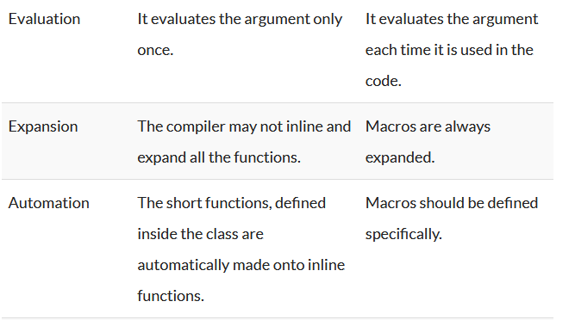
Subprogram and Control Abstraction
s

Slide 100
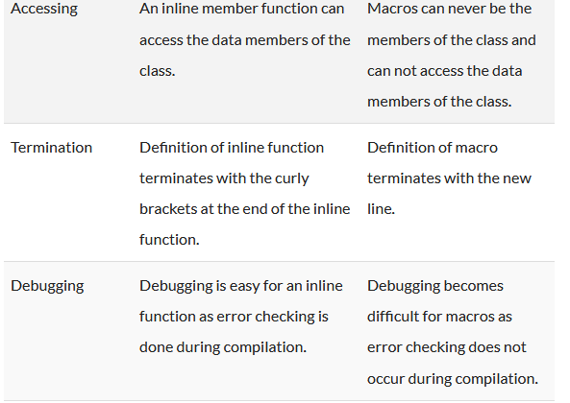
Subprogram and Control Abstraction
s

Slide 101
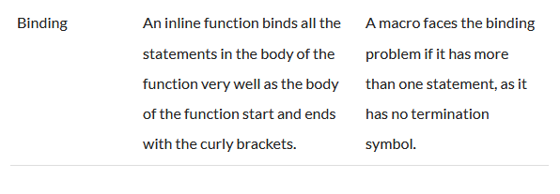
Subprogram and Control Abstraction
s

Slide 102
Exception Handling with class:
We can use Exception handling with class too. Even we can throw an exception of user defined class types. For throwing an exception of say demo class type within try block we may write

Slide 103
#include <iostream>
using namespace std;
class demo1 {
};
class demo2 {
};
int main()
{
for (int i = 1; i <= 2; i++) {
try {
if (i == 1)
throw demo1();
else if (i == 2)
throw demo2();
}
catch (demo1 d1) {
cout << "Caught exception of demo1 class \n";
}
catch (demo2 d2) {
cout << "Caught exception of demo2 class \n";
}
}
}
Caught exception of demo1 class
Caught exception of demo2 class

Slide 104
Exception handling can also be implemented with the help of inheritance. In case of inheritance object thrown by derived class is caught by the first catch block.
int main()
{
for (int i = 1; i <= 2; i++) {
try {
if (i == 1)
throw demo1();
else if (i == 2)
throw demo2();
}
catch (demo1 d1) {
cout << "Caught exception of demo1 class \n";
}
catch (demo2 d2) {
cout << "Caught exception of demo2 class \n";
}
}
}
#include <iostream>
using namespace std;
class demo1 {
};
class demo2 : public demo1 {
};
Caught exception of demo1 class
Caught exception of demo1 class
Explanation: The program is similar to previous one but here we have made demo2 as derived class for demo1.Note the catch block for demo1 is written first.As demo1 is base class for demo2 an object thrown of demo2 class will be handled by first catch block.That is why output as shown.

Slide 105
Exception handling can also be implemented by using constructor. Though we cannot return any value from the constructor but with the help of try and catch block we can.
#include <iostream>
using namespace std;
class demo {
int num;
public:
demo(int x)
{
try {
if (x == 0)
// catch block would be called
throw "Zero not allowed ";
num = x;
show();
}
catch (const char* exp) {
cout << "Exception caught \n ";
cout << exp << endl;
}
}
void show()
{
cout << "Num = " << num << endl;
}
};
int main()
{
// constructor will be called
demo(0);
cout << "Again creating object \n";
demo(1);
}
Exception caught
Zero not allowed
Again creating object
Num = 1
Explanation: when x = 0 exception is thrown and catch block is called. And when x = 1 no exception is created .

